Slide 1
Data Science and AI Lab Project
GROUP I
RAG-BASED LLM CODE REVIEW AGENT
MILESTONE 2

Slide 2


Problem Statement
Build an automated Python code review assistant that analyzes pull request diffs.
The system detects five categories of issues:
Indentation inconsistencies
Naming convention violations
Unused imports
Mutable default arguments
Documentation / formatting issues

Slide 3
Objectives
Identifying reliable data sources
Constructing structured datasets from raw pull request diffs
Ensuring dataset quality and consistency
Preparing retrieval knowledge for the RAG architecture
Creating evaluation datasets with ground-truth annotations

Slide 4

Data PREPARATION Pipeline
01
Data Extraction
Pull request diffs collected from GitHub repositories.
02
Diff Processing
Parse diff files into structured code chunks.
03
Data Cleaning
Normalize formatting and remove duplicate entries.
04
Violation Labeling
Assign coding rule categories to review comments.
05
Dataset Splitting
Separate datasets into Retrieval Corpus and Evaluation Dataset.
06
Knowledge Chunking
Split guidelines and documents into retrieval units.

Slide 5


GIhub repository Sources
Repositories Used
django/django
pandas-dev/pandas
scikit-learn/scikit-learn
pallets/flask
fastapi/fastapi
These repositories were selected because they:
Are actively maintained
Contain large numbers of pull requests
Have meaningful review discussions
Follow Python style guidelines

Slide 6

01
Evaluation Dataset
Evaluate model predictions
Dataset Overview
02
Retrieval Corpus
Knowledge base for RAG
03
Static Analysis Input
Baseline linter evaluation

Slide 7
Dataset Split Strategy
To prevent data leakage in the retrieval system, datasets were separated at the repository level.
Training Repositories
Used for building the Retrieval Corpus
django/django
pandas-dev/pandas
scikit-learn/scikit-learn
Evaluation Repositories
Used only for model evaluation
pallets/flask
fastapi/fastapi

Slide 8
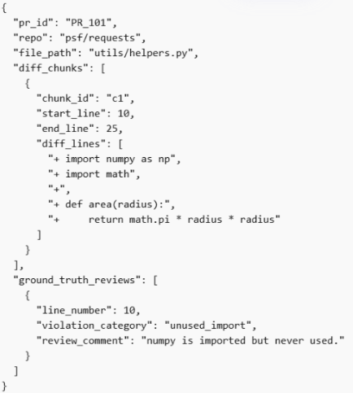
Evaluation Dataset
Source: GitHub pull requests
Contains:
Pull request diffs
Diff chunks
Line numbers
Ground truth review comments
Violation categories
Purpose:
Evaluate model predictions against human reviewer feedback.

Slide 9
GITHUB data collection
Data Collection Strategy
Systematic API pagination
1-second delay between requests to respect rate limits
Automatic retry after 403 responses
All responses cached locally (cache/ directory) for reproducibility
Raw Dataset Size
25,000 review comments
98 pull request file change sets
Collected from 5 Python repositories

Slide 10
Data Cleaning & Filtering Strategy
Raw Comment Filtering
Only comments related to .py files were retained
Bot Exclusion
Automated bot-generated comments removed
Minimum Length Filter
Skip comments if, len(comment.body.strip()) < 15
Text Tokenization Repair
Applied 16 regex-based repairs to normalize text
Deduplication
Removed duplicate review comments
Diff Noise Removal
Stripped @@ diff hunk headers
Origin Tagging
Each comment tagged with its repository source
Ground Truth Cross-Validation
Verified violation annotations
Stratified Sampling
Balanced samples across violation categories
LLM Response Validation
Verified classification responses

Slide 11
Retrieval Corpus
(RAG Knowledge Base)
The retrieval corpus contains coding knowledge used by the RAG model.
Sources:
PEP8 coding guidelines
PEP257 docstring rules
Repository style guides
Linter rule explanations
Accepted review comments
Example:
{
"chunk_id": "guideline_32",
"text": "Avoid importing modules that are not used in the file. Unused imports make code harder to read.",
"category": "unused_import",
"source_type": "project_guideline"
}

Slide 12
Retrieval Corpus Preparation
Chunking Strategy:
200–400 tokens per chunk
One rule per chunk
Minimal overlap
Embedding Model:
bge-large-en-v1.5
Embeddings stored in:
FAISS Vector Database
Used for semantic retrieval during code review

Slide 13
Static Analysis Dataset
Used to run baseline tools:
Pylint
Flake8
Dataset contains:
File path
Code diff
Full code context
Example structure:
{
"file_path": "utils/helpers.py",
"diff_code": "import numpy as np\nimport math\n..."
}
These tools generate rule-based violation reports that serve as a baseline for comparison with LLM-based systems.

Slide 14
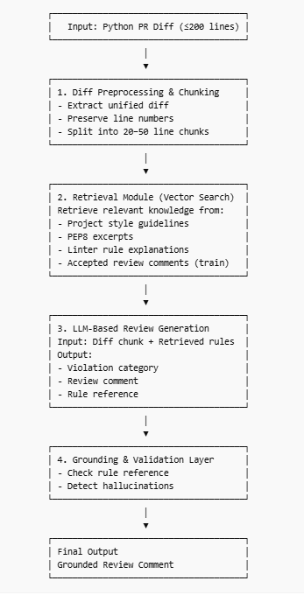
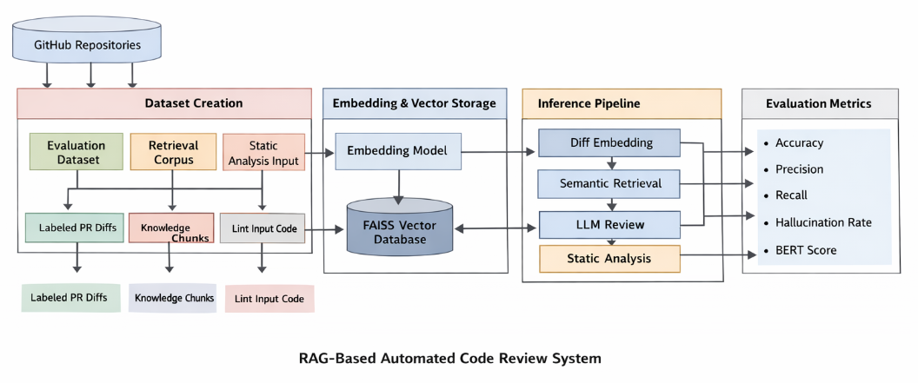
System ARCHITECTURE

